Slide 1
“Risk Management and Tools”

Slide 2
Risks
As a project manager, knowing what could go wrong during your project can help you set your team members up for success. For example, what if project stakeholders propose a new app and you don’t consider the time and resources it will take to create it? When the app heads to the development team, the project is at risk of falling apart before it starts.
When you know the potential risks for each project, you can create reasonable project objectives and keep the team on track.

Slide 3
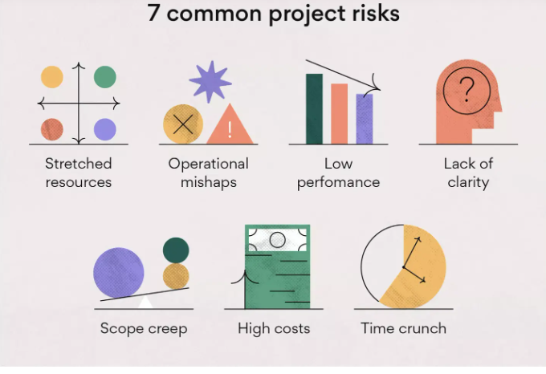

Slide 4
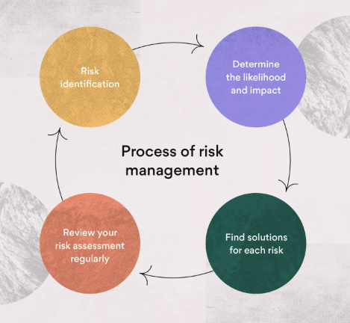
Risks Maangement
Risk management involves identifying what risk categories are most likely to affect your project and making a plan to mitigate those risks.

Slide 5
Risk identification
The first step in the risk analysis process is identifying risks you think could affect your project. We mentioned the seven most common risk events above, but other project risks could include contractor failure, unexpected life events, data transfer issues, shifting priorities, legal risk, market risk, and project deferral.
Ask yourself these questions below to begin the risk identification process:
What is the likelihood of this risk event?
What are the impact and severity if the risk occurs?
What is our risk response plan?
Given the likelihood and impact, what is the priority level?
Who owns this risk?
Once you have an answer to these questions, you’ll continue the risk management process through prioritization of risks, actionable solutions, and regular monitoring.

Slide 6
Determine the likelihood and impact
You can sort through your list of risks by determining which ones are most likely to occur. Placing the risks in order of likelihood will give you a better idea of which risks to prioritize as you prepare a plan of action.
Not only is the likelihood of occurrence important when prioritizing risks, but assessing the business impact of each risk matters as well. You should plan more carefully for the risks that have the potential to cause significant business impact.

Slide 7
Find solutions for each risk
Creating a game plan on how your team will deal with each risk is the goal when conducting risk assessments. Sorting risks based on likelihood and business impact will give you a starting point for finding solutions. Conducting a risk assessment will make your projects more successful because you can prevent risk along the way.
You can meet with relevant project stakeholders to proactively identify reasonable solutions for project risks that might be top of mind for them

Slide 8
Monitor your risk assessment regularly
Once you’ve developed your risk assessment, it’s important to monitor it regularly because circumstances can change. The likelihood of risk can shift and so can the business impact.
It’s also possible that new risks can come into play or risks that were once possible may become less likely. Monitoring your risk assessment regularly can make you feel the most prepared for uncertain events.

Slide 9
Project risk management tools
The right tools can make the risk assessment process easier because they allow you to analyze and prioritize risk. With real-time tracking and shared information in one place, everyone on your team can have instant access to project materials and you can monitor team progress.
Project management tools can also help your team develop strong project planning skills. Knowing your process and the project management phases can prevent risks before they occur.

Slide 10
Risk register
A risk register is the ultimate tool for identifying and prioritizing risk. A risk register should include the likelihood of each risk, the business impact, how you hope to prevent the risk, how you plan to respond to the risk if it occurs, and who will take action.
After completing a risk register, you’ll have a living document to use when working through projects. You can reference this information as you encounter risks and use it to reduce long-term damage.

Slide 11
Risk Register Uses
There are many instances when a risk register comes in handy. Ideally, it should be used—or available for use when needed—for every project. It can be used for both small and large projects, though your risk log may look different depending on the scope and complexity of your initiative.
While a small project may only include basic information about the risk such as likelihood, priority, and solutions, a more complicated project may require around 10 different document fields.

Slide 12
Risk Pirority
Low priority: Risks such as lack of communication and scheduling errors can leave projects open to scope creep and missed deliverables.
Medium priority: Risks such as unplanned or additional work can cause teams to struggle with productivity and create unclear objectives.
High priority: Risks such as data security and theft can leave your company open to revenue loss and should be prioritized.
Once you know when to use a risk register, you can properly define high priority risks when you come across them.

Slide 13
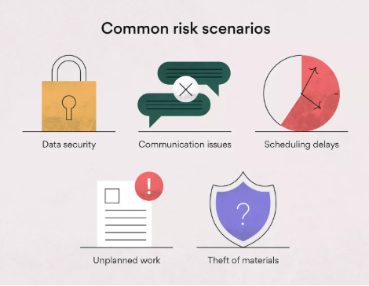
Risks Senarios
Multiple risks could arise during a new project. Anything from data security to unplanned work can risk projects going over budget and scope. Nobody wants to imagine the consequences of missed due dates, which is why it’s important to identify potential risks before they happen.

Slide 14
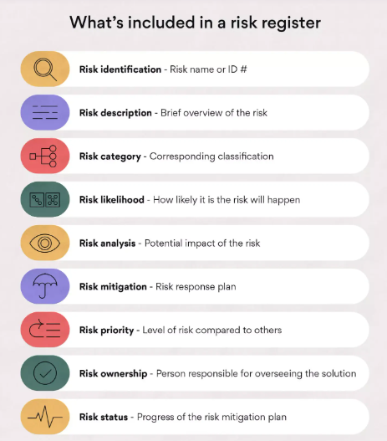
Risk Register Fields
A risk register is made of a list of risks and tracking fields. Your team’s risk log will most likely look different than others as you’ll have unique risks associated with your projects.

Slide 15
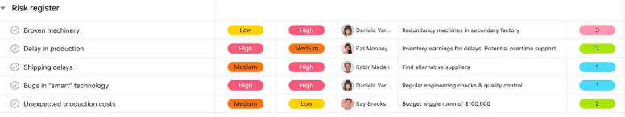
Risk Register Example
The key objective of a risk register is to log the information of potential risks, so don’t get too caught up in the details. You should choose the fields necessary to communicate potential risks to your team members.
Some teams may only need a simple risk register with few fields, while others may need something more complex. It may be helpful to start simple and work your way up to a more complex log if needed.

Slide 16
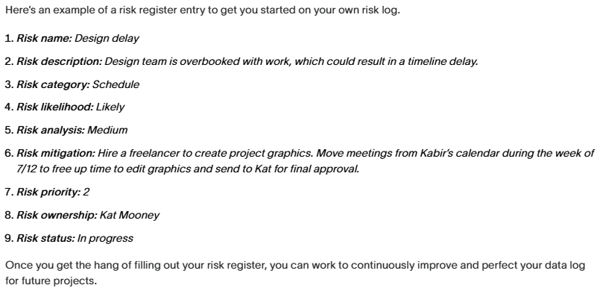
Risk Register Example

Slide 17
Risk Matrix
A risk matrix is a risk analysis tool to assess risk likelihood and severity during the project planning process.
Once you assess the likelihood and severity of each risk, you can chart them along the matrix to calculate risk impact ratings.
These ratings will help your team prioritize project risks and effectively manage them.

Slide 18
Types of risks
As part of the process, you’ll need to brainstorm a list of risks to chart in your risk matrix. The risks you may face will likely fall into these categories:
Strategic risk: Strategic risks involve performance or decision errors, such as choosing the wrong vendor or software for a project.
Operational risk: Operational risks are process errors or procedural mistakes, like poor planning or a lack of communication among teams.
Financial risk: Financial risk can involve various events that cause a loss of company profit, including market changes, lawsuits, or competitors.
Technical risk: Technical risk may include anything related to company technology, such as a security breach, power outage, loss of internet, or damage to property.
External risk: External risks are out of your control, like floods, fires, natural disasters, or pandemics.

Slide 19
Risk Categories and Risk Severity
There are other risk categories to consider depending on your work industry. For example, if you have government clients, then you also want to brainstorm legal risks. If your company sells a physical product, you may have to think about manufacturing risks.
When creating your risk matrix template, you’ll first identify your scale of severity, which you’ll place in the columns of your matrix. ​​The scale of severity measures how severe the consequences will be for each risk. In a five-by-five matrix, there are five levels in your scale of severity.

Slide 20
Risk Severity
Negligible (1): The risk will have little consequences if it occurs.
Minor (2): The consequences of the risk will be easy to manage.
Moderate (3): The consequences of the risk will take time to mitigate.
Major (4): The consequences of this risk will be significant and may cause long-term damage.
Catastrophic (5): The consequences of this risk will be detrimental and may be hard to recover from

Slide 21
Risk Likely Hood
You’ll then identify your scale of likelihood, which you’ll place in the rows of your risk matrix template. The scale of likelihood identifies the probability of each risk occurring.
Very likely (5): You can be pretty sure this risk will occur at some point in time.
Probable (4): There’s a good chance this risk will occur.
Possible (3): This risk could happen, but it might not. This risk has split odds.
Not likely (2): There’s a good chance this risk won’t occur.
Very unlikely (1): It’s a long shot that this risk will occur.

Slide 22
Risk Impact
When you place a risk in your matrix based on its likelihood and severity, you’ll find the level of risk impact. The risk impact is both color-coded from green to red and rated on a one through 25 scale.
Low (1-6): Low-risk events likely won’t happen, and if they do, they won’t cause significant consequences for your project or company. You can label these as low priority in your risk management plan.
Medium (7-12): Medium-risk events are a nuisance and can cause project hiccups, but if you take action during project planning to prevent and mitigate these risks, you’ll set yourself up for project success. You shouldn’t ignore these risks, but they also don’t need to be a top priority.
High (13-25): High-risk events can derail your project if you don’t keep them top of mind during project planning. Because these risks are likely to happen and have serious consequences, these are most important in your risk management plan.

Slide 23
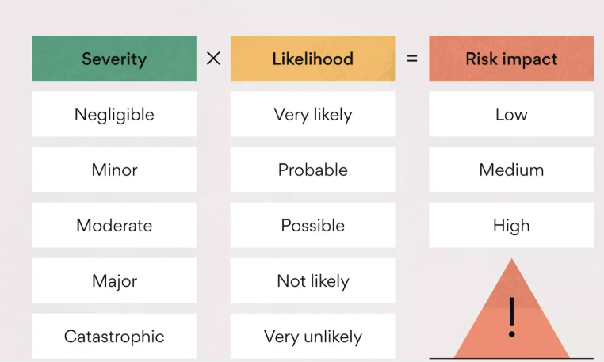

Slide 24
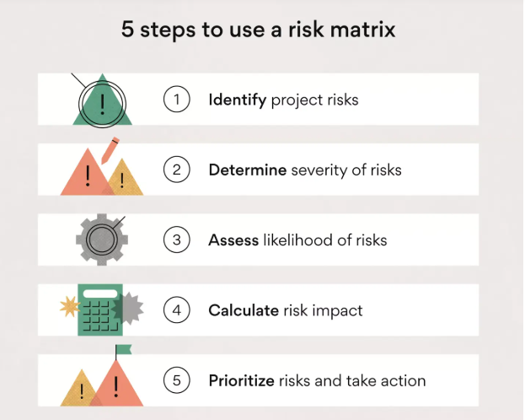
Risk Matrix Uses
Once you’ve created a risk matrix, you can use it as a comprehensive analysis tool. The best part about a risk matrix template is that you don’t need to change it for every project. Once you have one, you can reuse it and share it with others.

Slide 25
Risk assessment matrix template
The size of your risk matrix template determines how closely you can analyze your project risks. A larger risk matrix template offers more room on the risk impact spectrum, while a smaller risk matrix template keeps your risk impact rating simpler and less subjective.
Each square in your matrix represents a risk level of likelihood and severity, so you shouldn’t make your risk matrix smaller than three squares in length and width.
A five-by-five risk matrix is ideal so you can further analyze each risk. Once you chart your risks along your finished risk matrix template, this matrix creates a larger color spectrum to see the impact of each risk as high, medium, or low.

Slide 26
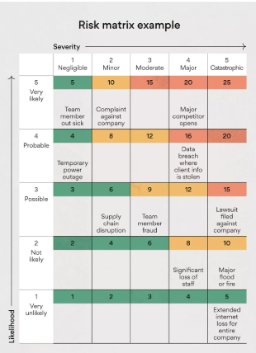

Slide 27
Decision Tree
A decision tree is a flowchart that starts with one main idea and then branches out based on the consequences of your decisions. It’s called a “decision tree” because the model typically looks like a tree with branches.
These trees are used for decision tree analysis, which involves visually outlining the potential outcomes, costs, and consequences of a complex decision.

Slide 28
Decison Tree
use a decision tree to calculate the expected value of each outcome based on the decisions and consequences that led to it. Then, by comparing the outcomes to one another,
you can quickly assess the best course of action. You can also use a decision tree to solve problems, manage costs, and reveal opportunities

Slide 29
Decision tree symbols
A decision tree includes the following symbols:
Alternative branches: Alternative branches are two lines that branch out from one decision on your decision tree. These branches show two outcomes or decisions that stem from the initial decision on your tree.
Decision nodes: Decision nodes are squares and represent a decision being made on your tree. Every decision tree starts with a decision node.
Chance nodes: Chance nodes are circles that show multiple possible outcomes.
End nodes: End nodes are triangles that show a final outcome.

Slide 30
You can use decision tree analysis to make decisions in many areas including operations, budget planning, and project management. Where possible, include quantitative data and numbers to create an effective tree. The more data you have, the easier it will be for you to determine expected values and analyze solutions based on numbers.
For example, if you’re trying to determine which project is most cost-effective, you can use a decision tree to analyze the potential outcomes of each project and choose the project that will most likely result in highest earnings.

Slide 31
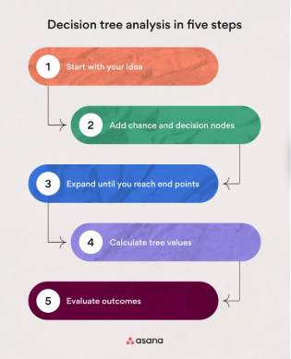
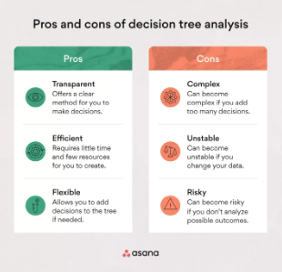
How to create a decision tree

Slide 32
Expected Value
For example, it’ll cost your company a specific amount of money to build or upgrade an app. It’ll also cost more or less money to create one app over another. Writing these values in your tree under each decision can help you in the decision-making process.
You can also try to estimate expected value you’ll create, whether large or small, for each decision. Once you know the cost of each outcome and the probability it will occur, you can calculate the expected value of each outcome using the following formula:
Expected value (EV) = (First possible outcome x Likelihood of outcome) + (Second possible outcome x Likelihood of outcome) - Cost
Calculate the expected value by multiplying both possible outcomes by the likelihood that each outcome will occur and then adding those values. You’ll also need to subtract any initial costs from your total.

Slide 33
Decision tree analysis example
In the decision tree analysis example below, you can see how you would map out your tree diagram if you were choosing between building or upgrading a new software app.
As the tree branches out, your outcomes involve large and small revenues and your project costs are taken out of your expected values.
Decision nodes from this example:
Build new scheduling app: $50K
Upgrade existing scheduling app: $25K
Build team productivity app: $75K

Slide 34
Chance nodes from this example:
Large and small revenue for decision one: 40 and 55%
Large and small revenue for decision two: 60 and 38%
Large and small revenue for decision three: 55 and 45%
End nodes from this example:
Potential profits for decision one: $200K or $150K
Potential profits for decision two: $100K or $80K
Potential profits for decision three: $250K or $200K

Slide 35
